Slide 1


Business Owners Program Domain KT for Progressive Team
Day -1

Slide 2
Day | Topics | Subtopics
1 | Concept | Meaning
 |  | Advantages
 |  | Eligibility Rules and its need
 |  | BOP Vs CPP
2 | Coverages | Commercial Property Insurance (BOP Vs CPP)
 |  | General Liability Insurance
 |  | Business Interruption Insurance
3 | Exclusions Endorsements Additional Coverages | What’s Not Covered?
 |  | Extra Expenses
 |  | Inland Marine
 |  | Equipment Breakdown
 |  | Spoilage
 |  | Employee Theft
 |  | Etc.
4 | BOP Rating & Premium Guidelines | Rating factors
 |  | Premium Guidelines
 |  | What Does a BOP Cost
 |  | Average Cost of a BOP
5 | BOP Policy issuance | BOP Policy Forms
 |  | Input Forms Output Forms
 |  | Valuation Methods
 |  | Policy Issuance Flow
 |  | Case study & Discussion- A snapshot at a Restaurant looking for insurance
 |  | Sample Policy
 |  | Declaration Page- A snap shot
 |  | Declaration Page- A snap shot
6 | Claims Handling | Property Damage Assessment and
 |  | Recovery for Business Owners
 |  | Filing a claim
 |  | Documents Required for Claim Process
 |  | Claims Flow Process

Slide 3
Concept | Meaning
 | Advantages
 | Eligibility Rules and its need
 | BOP Vs CPP

Slide 4
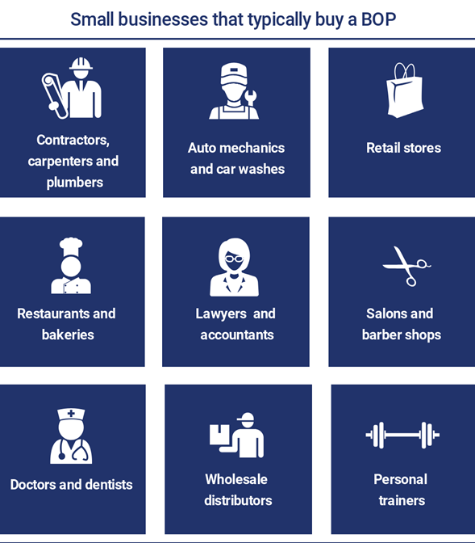
Who Is BOP Insurance for?
A Business Owners Policy is a policy package that was created with small businesses in mind. It was designed to cover many of the business risks that a majority of small businesses share, regardless of industry.
Large companies with more complex insurance needs usually don’t qualify for a BOP, meaning that the coverage they need can’t be provided by a Business Owners Policy. These large businesses would most likely be better off purchasing a variety of individual insurance policies that are all tailored to cover their specific needs based on their more complex risk profile.
If you fit into the following profile, a Business Owners Policy could probably be the right solution for covering your basic business insurance needs:
You have less than 100 employees
You make less than $10 million in annual sales
You have a physical location (could be your home) where most of your business is conducted

Slide 5
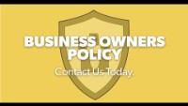
Notes:
A business owners policy (BOP) typically combines general liability insurance, property insurance and business interruption insurance into one package. A BOP is usually purchased by small and mid-sized businesses. And business owners insurance can be customized with additional coverage to fit the specific needs of a business.

Slide 6
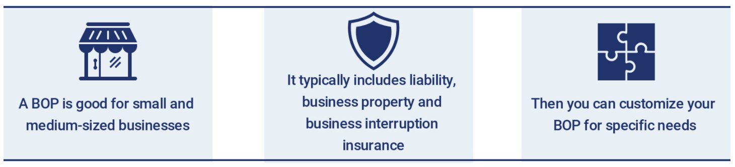

Slide 7
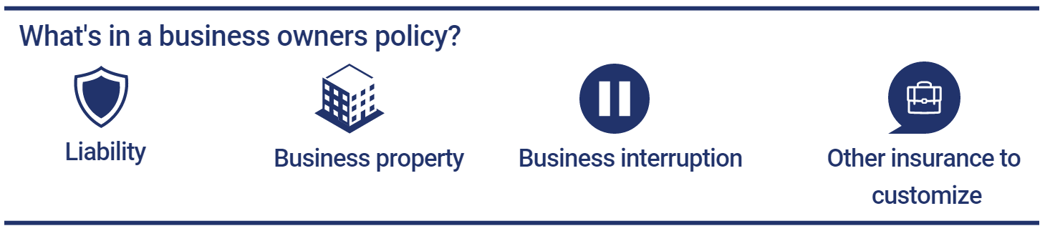

Slide 8
Why Do You Need a Business Owners Policy?
A Business Owners Policy can offer business owners peace of mind. This policy package makes it easy for business owners to maintain all of the most common insurance policies they need without having to manage several policies or sign contracts with different insurers. When you buy a BOP you have one policy that you’ve purchased from one insurer, making any eventual claims much simpler to handle.
A common misconception is that big companies need insurance more than small businesses. That simply isn’t true. While large companies might have more complex risks, one unforeseen event or misstep can be financially crippling to a small business if it is not insured.
A physical location
mechanical breakdown
A large business will probably have the money to pay for a lawsuit without insurance or repair their office if a hurricane destroys it. But with less cash flow, a small business most likely wouldn’t have the funds to cover the additional costs from such events. Insurance is there to provide financial support and relief for such unexpected circumstances.
The possibility of being sued
Employee dishonesty
Property that could be stolen or damaged.
Signs & seals
Notes:
Do you need a business owners policy?
It's a good idea to get a BOP if your business has:
A physical location. This could be out of your home, an owned or rented space, a store or any other work place.
The possibility of being sued. A BOP can cover lawsuits related to injured customers, reputational damage the business caused to others, or equipment that damages someone else's property.
Property that could be stolen or damaged. This could be anything from cash to data, equipment, furniture and inventory.

Slide 9
The Advantages of Having a BOP
The most obvious advantage of having a BOP is that it casts a wide net of protection and provides you with a broad range of coverage while having to only purchase one bundled policy.
The other most obvious benefit is the fact that you end up saving money. Every cent counts when you’re running a small business, which is why BOPs are an attractive option for smaller companies that needs basic insurance coverage and would like to spend as little as possible on it.
Another great thing about a BOP is that it can be modified and customized to fit your business’s specific needs. You buy what you need and you don’t buy what you don’t need. It’s very easy to add various endorsements to your BOP that will cover common risks such as equipment breakdown or personal and advertising injury.
Can be Easily hunted. It’s an incredibly popular insurance option that is offered by all the top insurers and even smaller insurance carriers, meaning that you can really shop around to find the best BOP for your business in terms of coverage and cost.

Slide 10
Advantages of BOP
Advantageous to insured, insurers, producers
Insured gains convenience of one policy that meets most of their needs
Reduced premium cost
Often with coverages included that might be overlook
Simplified rating used to determine premium as in HO
Lower handling cost for insurer and producer
Note: All Information contained herein is proprietary & confidential material of ValueMomentum Inc. All rights are reserved.
Notes:
Commercial package policy consisting of individual coverage forms e.g. BPP, Auto, CGL etc. are also available
Shorter list of property not covered – insureds are lower risks, homogenous businesses
Replacement cost as standard valuation provision – ACV is also available as an option
No coinsurance provision

Slide 11
Business Owners Program- What is it?
A Business Owners Policy (BOP) is a package of insurance policies that the majority of business owners need to have—which is why insurance carriers bundle these coverages and sell them as one product.
Commercial Property Insurance
Business Owners Program
Business Interruption Insurance
General Liability Insurance
More often than not, a BOP is sold to small and medium-sized businesses, since large corporations tend to have more complex risks that require customized policies.
In a typical BOP, businesses buy 3 major policies as one bundle or insurance package
Notes:
Insurance companies selling business insurance offer policies that combine protection from all major property and liability risks in one package. (They also sell coverages separately.) One package purchased by small and mid-sized businesses is the businessowners policy (BOP). Package policies are created for businesses that generally face the same kind and degree of risk. Larger companies might purchase a commercial package policy or customize their policies to meet the special risks they face.
BOPs include
Property insurance for buildings and contents owned by the company -- there are two different forms, standard and special, which provides more comprehensive coverage.
Business interruption insurance, which covers the loss of income resulting from a fire or other catastrophe that disrupts the operation of the business. It can also include the extra expense of operating out of a temporary location.
Liability protection, which covers your company's legal responsibility for the harm it may cause to others. This harm is a result of things that you and your employees do or fail to do in your business operations that may cause bodily injury or property damage due to defective products, faulty installations and errors in services provided.
BOPs do NOT cover professional liability, auto insurance, worker’s compensation or health and disability insurance. You'll need separate insurance policies to cover professional services, vehicles and your employees.

Slide 12
Are there Requirements for Purchasing a BOP? Its Eligibility & Need
You Own a home and need various coverages to protect various risks on home. Similarly when you own a Business you need to purchase various coverages to protect various business-related risks.
BOPs are to commercial lines insurance what homeowners' policies are to personal lines insurance.
Although a homeowners policy covers many individual and family property and liability insurance needs, additional insurance is usually necessary, such as auto insurance and personal umbrella insurance.
Suppose a company falls within the eligibility rules for a BOP, and the BOP coverage meets most of the basic coverage needs. In that case, a BOP should at least be a consideration when building the risk management program. The exposures not covered by the BOP can then be addressed separately.
Both Insurance Services Office, Inc. (ISO), and the American Association of Insurance Services (AAIS) have BOP programs. Many insurers have their own independently filed BOP forms—either company-specific endorsements used with the standard ISO or AAIS BOP forms or separate company-specific BOP forms used in place of the standard forms

Slide 13
Are there Requirements for Purchasing a BOP? Its Eligibility & Need
Every insurer has its own requirements that they look from an Insured, when it comes to selling a BOP.
the location of your business,
its size,
its revenue, and
class of business
This simply means that not all businesses qualify for a BOP and might have to purchase either a CPP or all of their policies separately.
Usually, insurers won’t offer a BOP to companies that handle their business off-premises.
Insurers usually have property parameters that go into their profile for a BOP and will not offer the policy package to businesses that have more or less property than they are willing to cover.
Some of the types of businesses that typically do qualify for a BOP.
Smaller, office-based businesses (lawyers, real estate agencies, and other professional service providers),
smaller restaurants and cafes, and
retail stores

Slide 14
BOP, Non-BOP, Micro BOP
It is important to note that a package policy and a BOP are not the same thing.
A package policy is a single policy that includes two or more coverages that are otherwise typically written as separate policies. Usually, the term package refers to policies that provide both property coverage and general liability coverage.
A BOP is a particular type of package policy that is written on BOP policy forms instead of using the monoline CGL and commercial property forms.
ISO and AAIS offer these two types of commercial package policies.
• BOPs for small businesses that qualify in terms of size and type of operations. BOPs are written on special BOP forms and are rated following special businessowners rules and rates.
• Commercial package or combination policies for businesses that are not eligible for the BOP program due to size or type of operations. These policies are written on monoline coverage forms, and each component is rated in accordance with monoline rules and rates, but a package policy discount is applied to eligible policies.
ISO also offers a third type of commercial package policy: a micro-businessowners policy (micro-BOP). The micro-BOP is designed for very small businesses with no more than four employees and very limited property loss exposures.

Slide 15
BOP Eligibility
The types of risks eligible for this program are summarized below.
Apartment buildings of any size, including residential condominium associations
Contractors subject to several restrictions, such as an annual payroll of $300,000 or less and doing no work at heights of more than three stories
Mercantile risks
Processing and service risks
Wholesale risks
Office buildings not over six stories tall or exceeding 100,000 total square feet
Motels not more than three stories tall, subject to no square foot restriction
Restaurants
Self-storage facilities
Convenience food/gasoline store/restaurants with limited cooking and fast food
Grocery stores and supermarkets that sell gasoline
Eligibility for a BOP generally is based on both the type and the size of the insured's business.
For example, ISO businessowners rules limit eligibility to firms with
no more than $6 million in annual gross sales and
no locations that exceed 35,000 in square footage (excluding basements that are not open to the public).

Slide 16
BOP Eligibility….Contd.
Business personal property in eligible apartment buildings, offices, and mercantile, wholesale, service, or processing operations is also eligible for BOP coverage. An owner-occupant's building and personal property must be insured in the same policy.
The following types of businesses currently are ineligible under ISO businessowners program rules, regardless of their size.
Manufacturers
Auto repair or service stations; auto, motor home, mobile home, and motorcycle dealers; parking lots or garages
Bars and pubs
Places of amusement
Banks and other financial institutions
Self-storage facilities that provide outdoor storage of motorized vehicles of any type
Naturally, the eligibility rules for independently filed BOP programs may vary from insurer to insurer.

Slide 17
What's not covered by a business owners policy?
Some problems require insurance that's not included in a BOP, such as:
Workers compensation insurance: Covers employees' work-related injuries and illness, plus some lost wages.
Health insurance: Businesses typically purchase group medical coverage for employee health insurance. Depending on the size of the business, you may qualify for a Small Business Health Options Program (SHOP).
Disability insurance: Pays part of an employee's salary while they're recovering from a non-work related illness, injury or pregnancy. You can typically buy both short-term and long-term disability insurance.

Slide 18

https://youtu.be/WJmq0RF7t5E

Slide 19
Endorsements and extra policies
Additional business owners insurance choices that can help fill any gaps in a business owners policy.
Commercial auto insurance: For vehicles used for business purposes.
Business income and extra expense: An addition to the business interruption part of a BOP, business income and extra expense insurance covers above-normal operating costs to avoid shutting down during the restoration of a business after a problem covered by the policy.
Crime insurance: For forgery, fraud and theft.
Cyber insurance: Covers a cyberattack, such as a data breach that compromises customers' personal information.
Errors and omissions insurance: For claims that you did not provide services that were expected or promised.
Employment practices liability insurance (EPLI): For claims by employees that their legal rights were violated, such as breach of contract, discrimination and harassment.
Equipment breakdown insurance Also known as boiler and machinery insurance or mechanical insurance, this covers lost income due to electrical or mechanical breakdown of equipment, such as computers, engines, generators, refrigerators and phone systems.
Product liability insurance: For legal expenses, settlements and judgments if a product causes injury, illness or property damage.

Slide 20
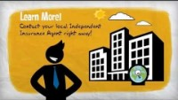
Briefing it - BOP Insurance for?

Slide 21
BOP insurance cost
The cost of a business owners policy depends on factors that will be unique to the business, including:
Type of business. For example, if you work with heavy machinery or dangerous chemicals, the business has a higher risk than a barber shop.
Size of business. Generally, the more employees the more potential risk. Also, the more property you've got, the higher the insurance cost.
Location and type of property. If your property has higher risks, such as theft or fire, expect to pay more.
A history of claims. If the business has made claims in the past, it could be seen as a higher risk.
A BOP not only offers the convenience of combining several coverages types under one policy, but it can also save you money. Bundling several coverage types from the same insurance company often leads to a discount.

Slide 22
BOP Vs CPP & CGL
What’s The Difference Between a Business Owners Policy and a Commercial Package Policy (CPP)?
The main difference between a BOP and a CPP is that the CPP is :
BOP is much more flexible,
which means that your business has greater options when it comes to putting together a coverage package that works best for your company’s specific needs.
In any case, whether or not you purchase a BOP or CPP is going to depend on two things;
your coverage needs and
your eligibility.

Slide 23
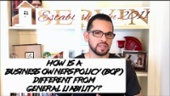
https://youtu.be/fIEDC5Ybcps

Slide 24
What’s the Difference Between a BOP and General Liability?
While this might seem like a concept that’s easy to understand, it’s still one of the most commonly asked questions by business owners who want to buy their first insurance policies.
The difference between a BOP and general liability is that a BOP provides more coverage. A BOP will cover the liability losses that a general liability policy will cover, but it will also cover property losses and business interruption costs.
A commercial general liability policy typically covers third-party property damage, bodily injury, and advertising injury, along with defense costs if you are being sued for a covered loss.
A BOP covers all this as well since commercial general liability is an integral part of the policy package, but it also covers your business property. That means that it can cover everything a commercial property policy covers, including property damage, loss and restoration of paperwork and records, equipment breakdown, and more.
A BOP can be customized to fit your business needs, which means that additional coverages can be added to it, even commercial auto insurance. General liability covers what it covers and you can’t add different types of coverages to this policy like you can to a BOP.
A BOP is a perfect solution for a small business with a low-risk profile and basic coverage needs.

Slide 25
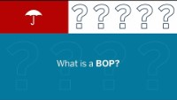

Conclusion
https://youtu.be/VTxi4crWVD8
https://youtu.be/dGMFqu8hrkM

